Slide 1
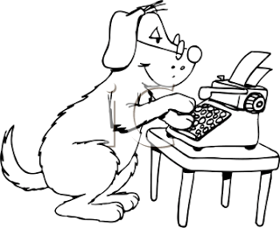
“Speed Typer”
The game that is all about typing, typing at speed...

Slide 2
Instructions
Click a challenge, press play and type the letter that comes up.
Web only game.
Screens: main, game, scores.

Slide 3
Challenges
Challenge 1: The ABC’s
Description: Type the alphabet in chronological order.
Letters: ABCDEFGHIJKLMNOPQRSTUVWXYZ
Challenge 5: Count to 20
Description: 0-20
Letters: 01234567891011121314151617181920
Challenge 2: ABC’s gone wrong
Description: Alphabet backwards
Letters: ZYXWVUTSRQPONMLKJIHGFEDCBA
Challenge 6: Random names
Description: A random persons name
Letters: STEVE or JOHN or EDWARD
Challenge 3: Brown Fox
Description: Classic typing exercise
Letters: THEQUICKBROWNFOXJUMPSOVERTHELAZYDOG
Challenge 7: Random letters
Description: Random sequence of letters
Letters: AONASO or UIOJNIQWE or WINEQUIY or PJHSULR or OLQWEL or KLLIHIJNQ
Challenge 4: Count to 10
Description: 0-9
Letters: 0123456789
Challenge 8: Double the number
Description: Starting at 1, double it and so on
Letters: 1, 2, 4, 8, 16, 32, 64, 128, 256, 512, 1024, 2048, 4096, 8192, 16384, 32768, 65536, 131072, 262144, 524288, 1048576

Slide 4
Menu/main screen
← Back
A-
A+
Prev
1
Next
PLAY
The ABC’s
ABC’s gone wrong
Options
Brown fox
About
Count to 10
Survival
Description
Type the alphabet.
Letters
ABCDEFGHIJKLMNOPQRSTUVWXYZ
Custom Game

Slide 5
Game screen
← Back
A-
A+
CHALLENGE - Alphabet Forwards
Type the alphabet in chronological order.
Type:
A
Press Space to restart
Time
00.00
Best Time
00.00

Slide 6
“Speed Typer -
Options”
Options screen
A-
A+
← Back
font size: 5
Alphabet
Reset score
Best time: 00.00
Alphabet
Reset score
Best time: 00.00
Survival
Reset score
Best time: 00.00
Alphabet
Reset score
Best time: 00.00
Alphabet
Reset score
Best time: 00.00
Prev
1
Next
Reset all scores

Slide 7
About screen
← Back
A-
A+
Speed Typer is based on the Finger Frenzy flash game and was created using Unity 3D.
Designer: Ian
Programmer: Ian

